Slide 1
PythonDS-09 List Data Structure and Its Methods
Dr. Naveen Kumar
Associate Professor
Amity Institute of Information Technology
Amity University Patna

Slide 2
Python Lists
A Python list is an ordered, mutable (changeable) collection of items that allows duplicate members and can contain mixed data types.
Key Characteristics
Ordered: Items maintain a defined order, which won't change unless explicitly modified.
Mutable: You can change, add, or remove items after the list has been created.
Allows Duplicates: Because items are indexed, the same value can appear multiple times.
Mixed (heterogeneous) Data Types: A single list can contain integers, strings, booleans, and even other lists (nested lists).
Index-based: Elements are accessed using zero-based indexing (the first element is at index 0).

Slide 3
Creating a List
Lists can be created in several ways:
Using square brackets:
my_list = ["apple", "banana", "cherry"]
Using the list() constructor:
my_list = list(("apple", "banana", "cherry"))
Using the multiplication operator:
repeated_list = ['Hi!'] * 4
#results in ['Hi!', 'Hi!', 'Hi!', 'Hi!']

Slide 4
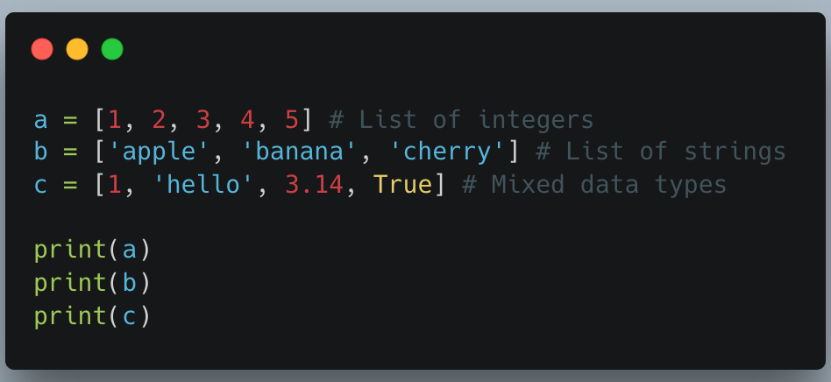

Slide 5
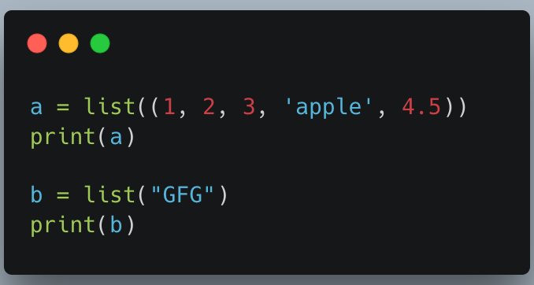

Slide 6
List Operations and Methods
Python provides numerous built-in methods and functions to work with lists.
Method Description Example
append() Adds a single element to the end of the list. list.append("orange")
insert() Inserts an element at a specified index. list.insert(1, "grape")
extend() Adds the elements of another iterable (like a list) to the end of the current list. list.extend(["melon", "kiwi"])
remove() Removes the first occurrence of a specified value. list.remove("banana")
pop() Removes and returns the item at a given index (or the last item if no index is specified). removed_item = list.pop(0)
del statement Deletes an element at a specific index or the entire list. del list[0]
sort() Sorts the list in place (modifies the original list). list.sort()
reverse() Reverses the order of elements in the list in place. list.reverse()
len() A built-in function that returns the number of items in the list. length = len(list)
index() Returns the index of the first occurrence of a specified value. index = list.index("cherry")

Slide 7
Accessing and Slicing Lists
Indexing: Use square brackets and the index number to access individual elements. e.g.,
my_list[0]
Negative Indexing: Access elements from the end of the list, starting with -1 for the last item. e.g.
my_list[-1]
Slicing: Extract a sub-list using a colon-separated start and end index. The slice includes the start index but excludes the end index.
my_list[1:3]

Slide 8
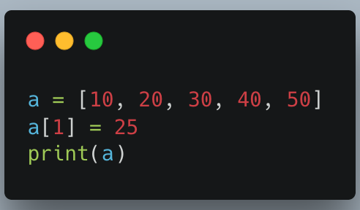
Updating Elements

Slide 9
Removing Elements from List
We can remove elements from a list using:
remove(): Removes the first occurrence of an element.
pop(): Removes the element at a specific index or the last element if no index is specified.
del statement: Deletes an element at a specified index.

Slide 10
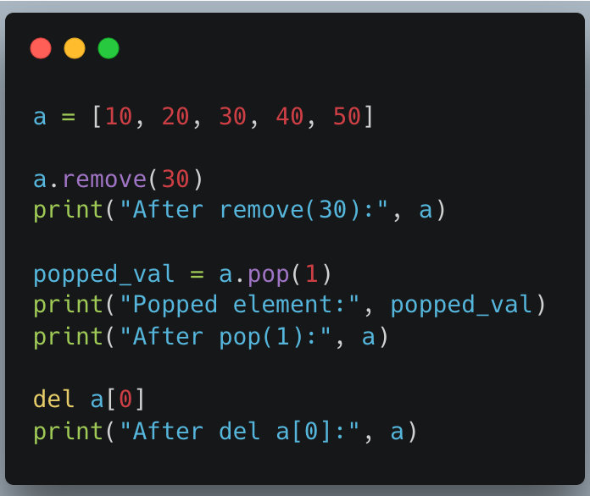

Slide 11
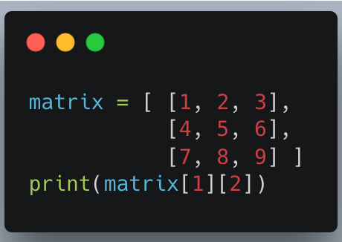
Nested Lists
A nested list is a list within another list, which is useful for representing matrices or tables. We can access nested elements by chaining indexes.

Slide 12
List Comprehensions
List comprehension offers a concise way to create new lists from existing iterables in a single line of code.
squares = [x**2 for x in range(1, 6)]
# Result: [1, 4, 9, 16, 25]

Slide 13
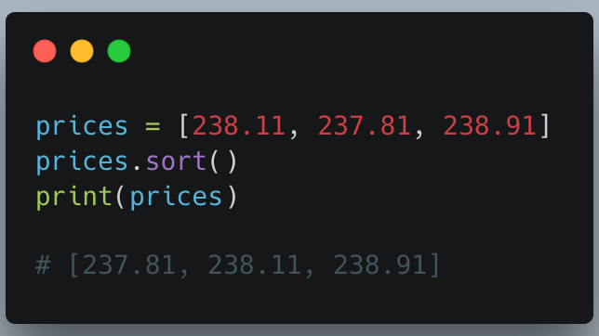
The sort() method is a built-in Python method that, by default, sorts the list in ascending order. However, you can modify the order from ascending to descending by specifying the sorting criteria.

Slide 14
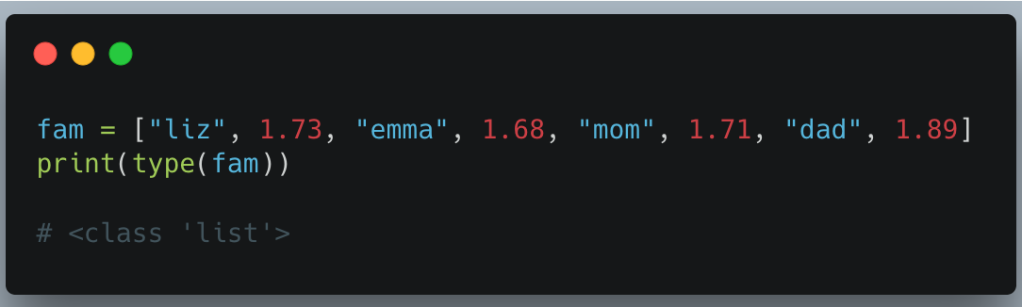
For the type() function, it returns the class type of an object.

Slide 15
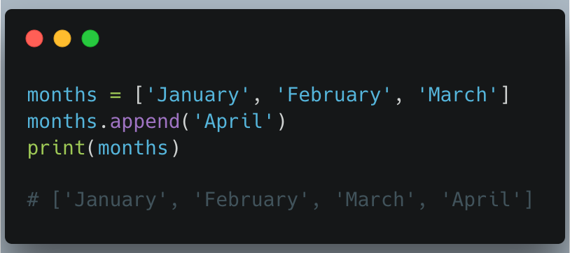
The append() method will add certain content you enter to the end of the elements you select.

Slide 16
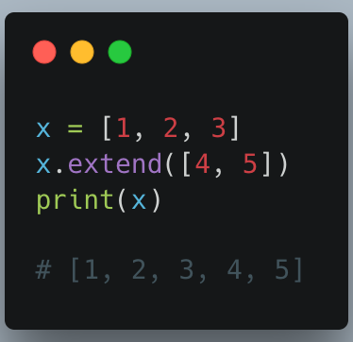
The extend() method increases the length of the list by the number of elements that are provided to the method, so if you want to add multiple elements to the list, you can use this method.

Slide 17
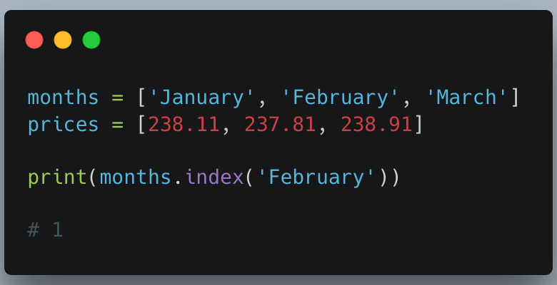
The index() method returns the first appearance of the specified value.

Slide 18
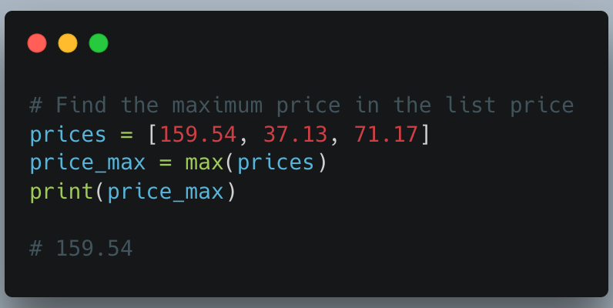
The max() function will return the highest value of the inputted values.

Slide 19
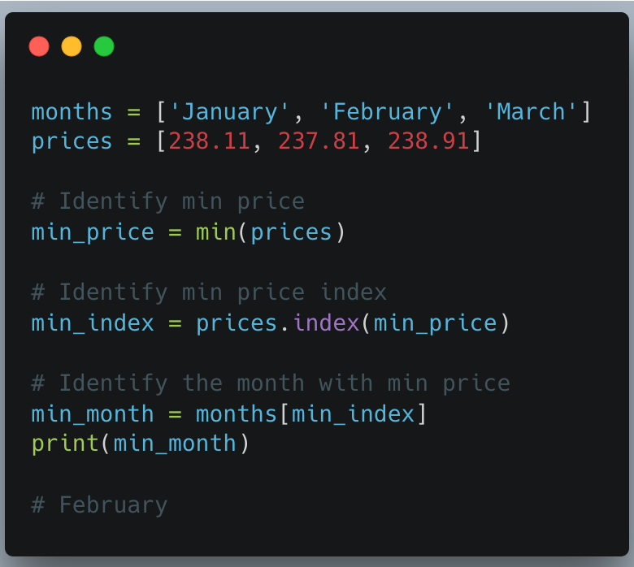
The min() function will return the lowest value of the inputted values.

Slide 20
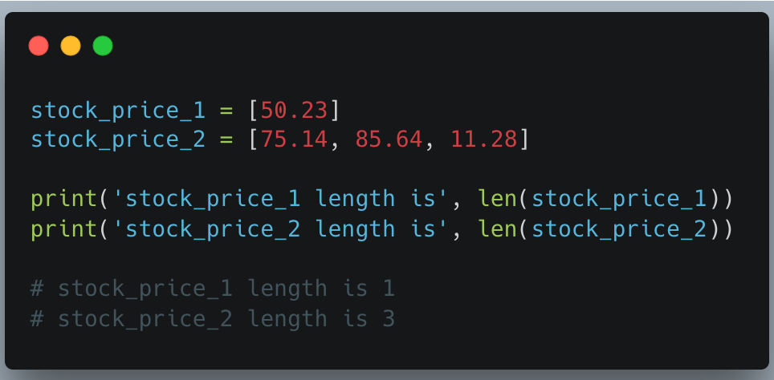
The len() function shows the number of elements in a list. In the below example, we will look at stock price data again using integers.

Slide 21
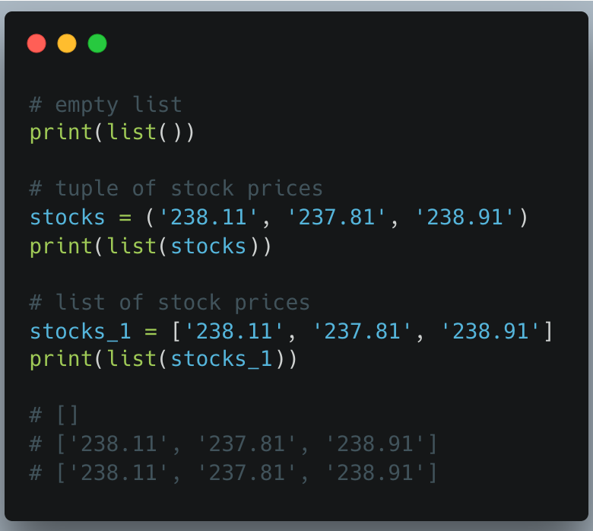
The list() function takes an iterable construct and turns it into a list.

Slide 22
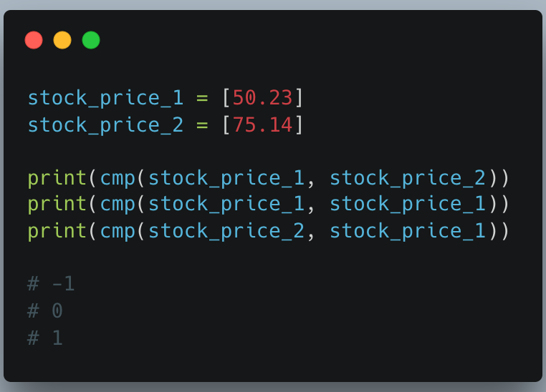
For the cmp() function, it takes two values and compares them against one another. It will then return a negative, zero, or positive value based on what was inputted.

Slide 23
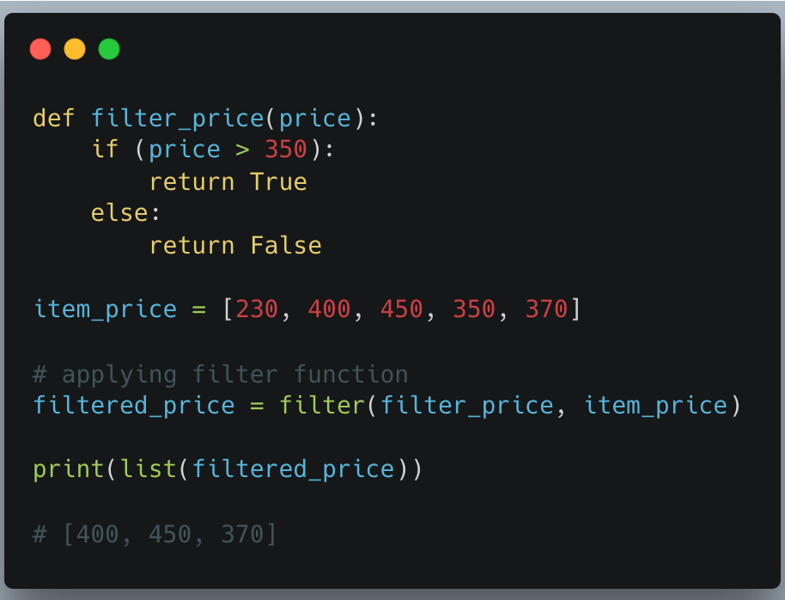
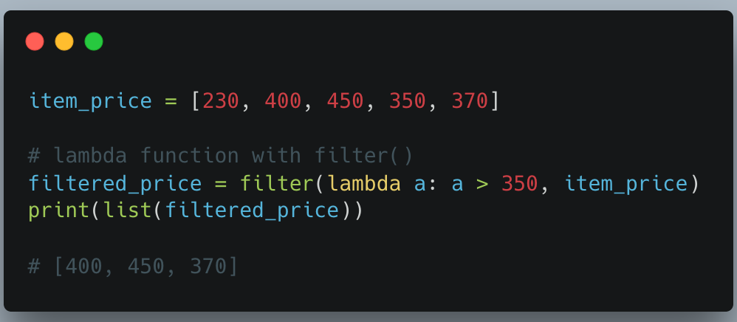
For the filter() function, it takes a function and the lists and returns an iterator of filtered elements. You can either create a Python filter function or use a lambda function to get a filtered list.

Slide 24
The sort() method is a built-in Python method that, by default, sorts the list in ascending order. However, you can modify the order from ascending to descending by specifying the sorting criteria.

Slide 25
How Python Stores List Elements?
In Python, a list doesn’t store actual values directly. Instead, it stores references (pointers) to objects in memory. This means numbers, strings and booleans are separate objects in memory and the list just keeps their addresses.
That’s why modifying a mutable element (like another list or dictionary) can change the original object, while immutables remain unaffected.

Slide 26
